Slide 1
MODULE 3 INTEGRATION
LOGIC & MEMORY DATAPATH
Digital Data Transmission Error Detection System
Design & Logisim Simulation using XOR Logic across Addressable Memory and Register File Buses

Slide 2

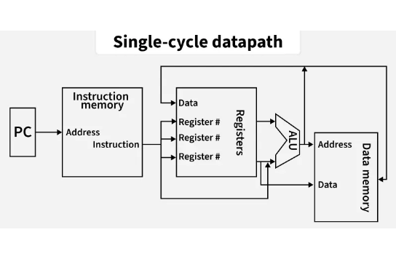
SYSTEM CONTEXT
Module 3 Storage & Data Transmission
Addressable Storage Buses
Data lines between CPU Register File and Memory face noise during write/read operations.
The von Neumann Bottleneck
Frequent data transfers across memory lines increase potential single-bit line corruption.
In-Line Error Checking
XOR logic provides low-latency error detection before data enters register storage.

Slide 3
LOGIC FOUNDATION
Exclusive OR (XOR) Logic for Parity
XOR Truth Table & Property
Input A | Input B | Output (A ⊕ B)
0 | 0 | 0
0 | 1 | 1
1 | 0 | 1
1 | 1 | 0
Odd Number of 1s Detection
Cascading XOR gates directly computes whether binary word data contains an even or odd count of HIGH bits.
Zero LUT Overhead
Implemented purely with combinational XOR gates without needing lookup memory or complex ALUs.
Modulo-2 Addition: Outputs HIGH (1) if and only if an odd number of inputs are 1.

Slide 4
TRANSMITTER LOGIC
4-Bit Even Parity Generator
1
2
3
Register Data Word
XOR Cascade Reduction
Bus Frame Assembly
Read 4 data bits (D0, D1, D2, D3) from CPU register file output ports.
Compute even parity bit P using boolean logic equation: P = D0 ⊕ D1 ⊕ D2 ⊕ D3.
Append check bit P to data payload creating a 5-bit codeword for bus transmission.

Slide 5

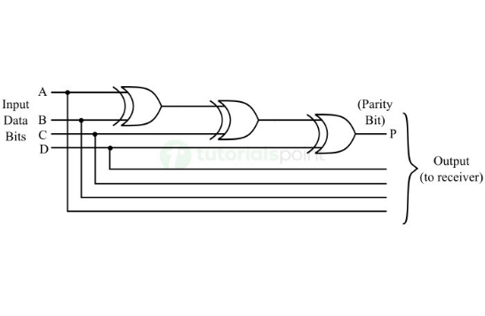
TRANSMISSION CHANNEL
Logisim Error Injection & Bus Simulation
Channel Noise Simulation
In Logisim, a single XOR gate with an Error_Inject toggle simulates real-world bus line noise.
Single Bit-Flip Mechanics
When Error_Inject = 0, bit passes untouched. When Error_Inject = 1, output bit inverts.

Slide 6
RECEIVER LOGIC
Parity Checker & Error Flag
Codeword Reception
Full XOR Reduction
Error Alert Generation
Receive 5 incoming bus lines: D0', D1', D2', D3', and parity bit P'.
Compute error status: Error = D0' ⊕ D1' ⊕ D2' ⊕ D3' ⊕ P'.
Output 0 indicates clean transmission; Output 1 triggers bus error flag.

Slide 7
CIRCUIT ARCHITECTURE
Balanced XOR Tree in Logisim
Data Inputs: D0, D1
→ [ XOR Gate 1 ] →
Intermediate (D0 ⊕ D1)
Data Inputs: D2, D3
→ [ XOR Gate 2 ] →
Intermediate (D2 ⊕ D3)
Tree Final Stage:
[ XOR Gate 3 ]
Parity Bit P
Balanced binary tree topology reduces propagation delay from 3t_pd to 2t_pd compared to linear cascade.

Slide 8
SOFTWARE MODELING
Basic Java Parity Implementation
// Basic Java XOR Parity Logic boolean d0 = true, d1 = false; boolean d2 = true, d3 = true; // 1. Generate Even Parity Bit boolean parity = d0 ^ d1 ^ d2 ^ d3; // 2. Simulate Error Injection (Bit Flip) boolean corruptedD1 = !d1; // Flip D1 // 3. Receiver Error Verification boolean hasError = d0 ^ corruptedD1 ^ d2 ^ d3 ^ parity; System.out.println("Error Detected: " + hasError); // Output: Error Detected: true
// Basic Java XOR Parity Logic boolean d0 = true, d1 = false; boolean d2 = true, d3 = true; // 1. Generate Even Parity Bit boolean parity = d0 ^ d1 ^ d2 ^ d3; // 2. Simulate Error Injection (Bit Flip) boolean corruptedD1 = !d1; // Flip D1 // 3. Receiver Error Verification boolean hasError = d0 ^ corruptedD1 ^ d2 ^ d3 ^ parity; System.out.println("Error Detected: " + hasError); // Output: Error Detected: true
Java Bitwise Operator
The `^` operator directly mirrors hardware XOR gate behavioral logic.
Direct Equivalence
Software boolean expression maps 1:1 to Logisim combinational gate schematics.

Slide 9
STORAGE VERIFICATION
Verifying Storage Read/Write Operations
1. Write Test
2. Bus Transfer
3. Read Check
4. Status Flag
Store data word with XOR parity into CPU register file.
Transmit codeword over memory address/data lines.
Execute XOR parity reduction on read cycle.
Flag CPU pipeline to retry memory fetch if error detected.

Slide 10
SYSTEM ANALYSIS
Capabilities vs. Limitations
What Single XOR Detects
System Limitations
Single-Bit Flips: 100% detection rate for any single wire fault.
Even Bit Flips: Blind to 2-bit or 4-bit simultaneous errors.
Odd Multi-Bit Errors: Detects 3, 5, or 7 bit flips across the bus.
No Correction: Detects corruption but cannot identify which bit flipped.
Minimal Overhead: Requires only 1 extra bit per data word.
Module 4/5 Upgrade: Hamming code needed for error correction.

Slide 11
MODULE 3 BOUNDARY
Module 3 Storage & XOR System Metrics
100%
0
2 tpd
Single-Bit Error Detection
ALU / Lookup Memory Needed
Balanced Tree Delay
Module Scope: Registers & flip-flops remain provided black boxes. Sequential elements (Module 4), ALUs (Module 5), and general gate implementations (Module 6) build upon this datapath parity model.

Slide 12
System Simulation Complete
Digital Data Transmission Error Detection using XOR Logic integrated with Module 3 Memory & Register File
Questions & Logisim Demonstration

